Slide 1



Cosmo: Contrastive Fusion Learning with Small Data for Multimodal Human Activity Recognition
Xiaomin Ouyang¹, Xian Shuai¹, Jiayu Zhou², Ivy Wang Shi³, Zhiyuan Xie¹
Guoliang Xing¹, and Jianwei Huang⁴
¹The Chinese University of Hong Kong, ²Michigan State University,
³Li Po Chun United World College, Hong Kong
⁴The Chinese University of Hong Kong, Shenzhen

Slide 2
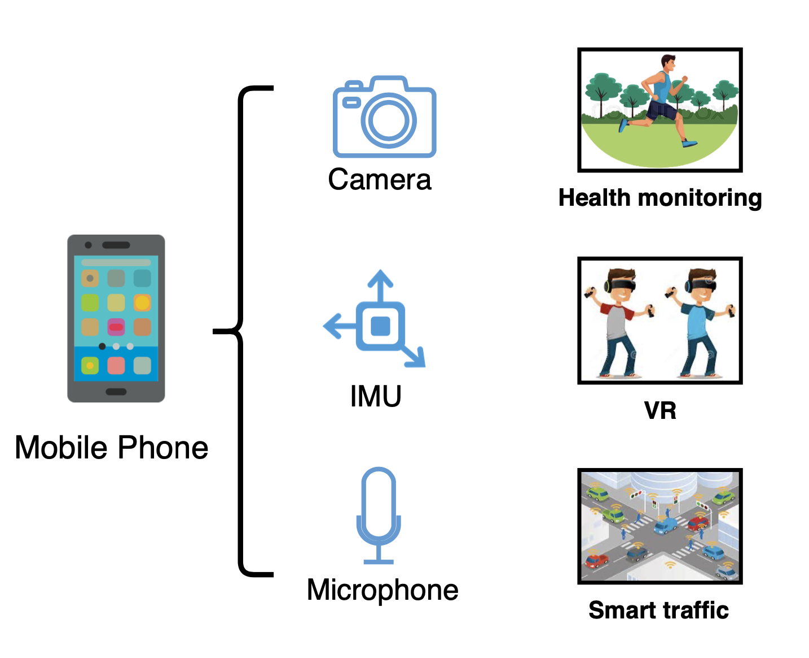
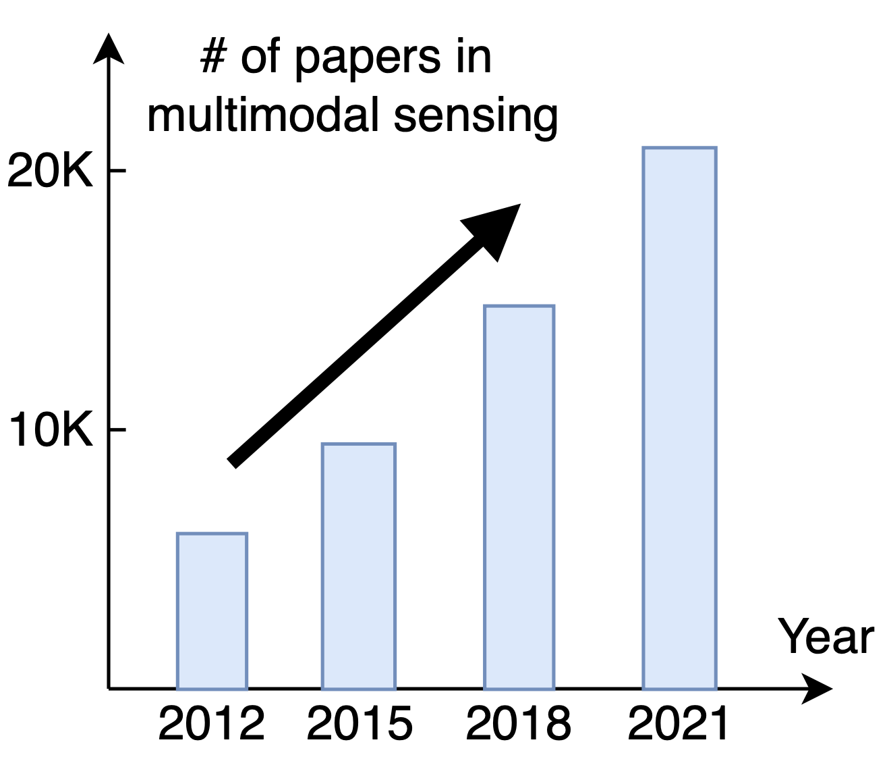

Sensing with Multiple Modalities
Human senses
Mobile devices
Emerging studies

Slide 3
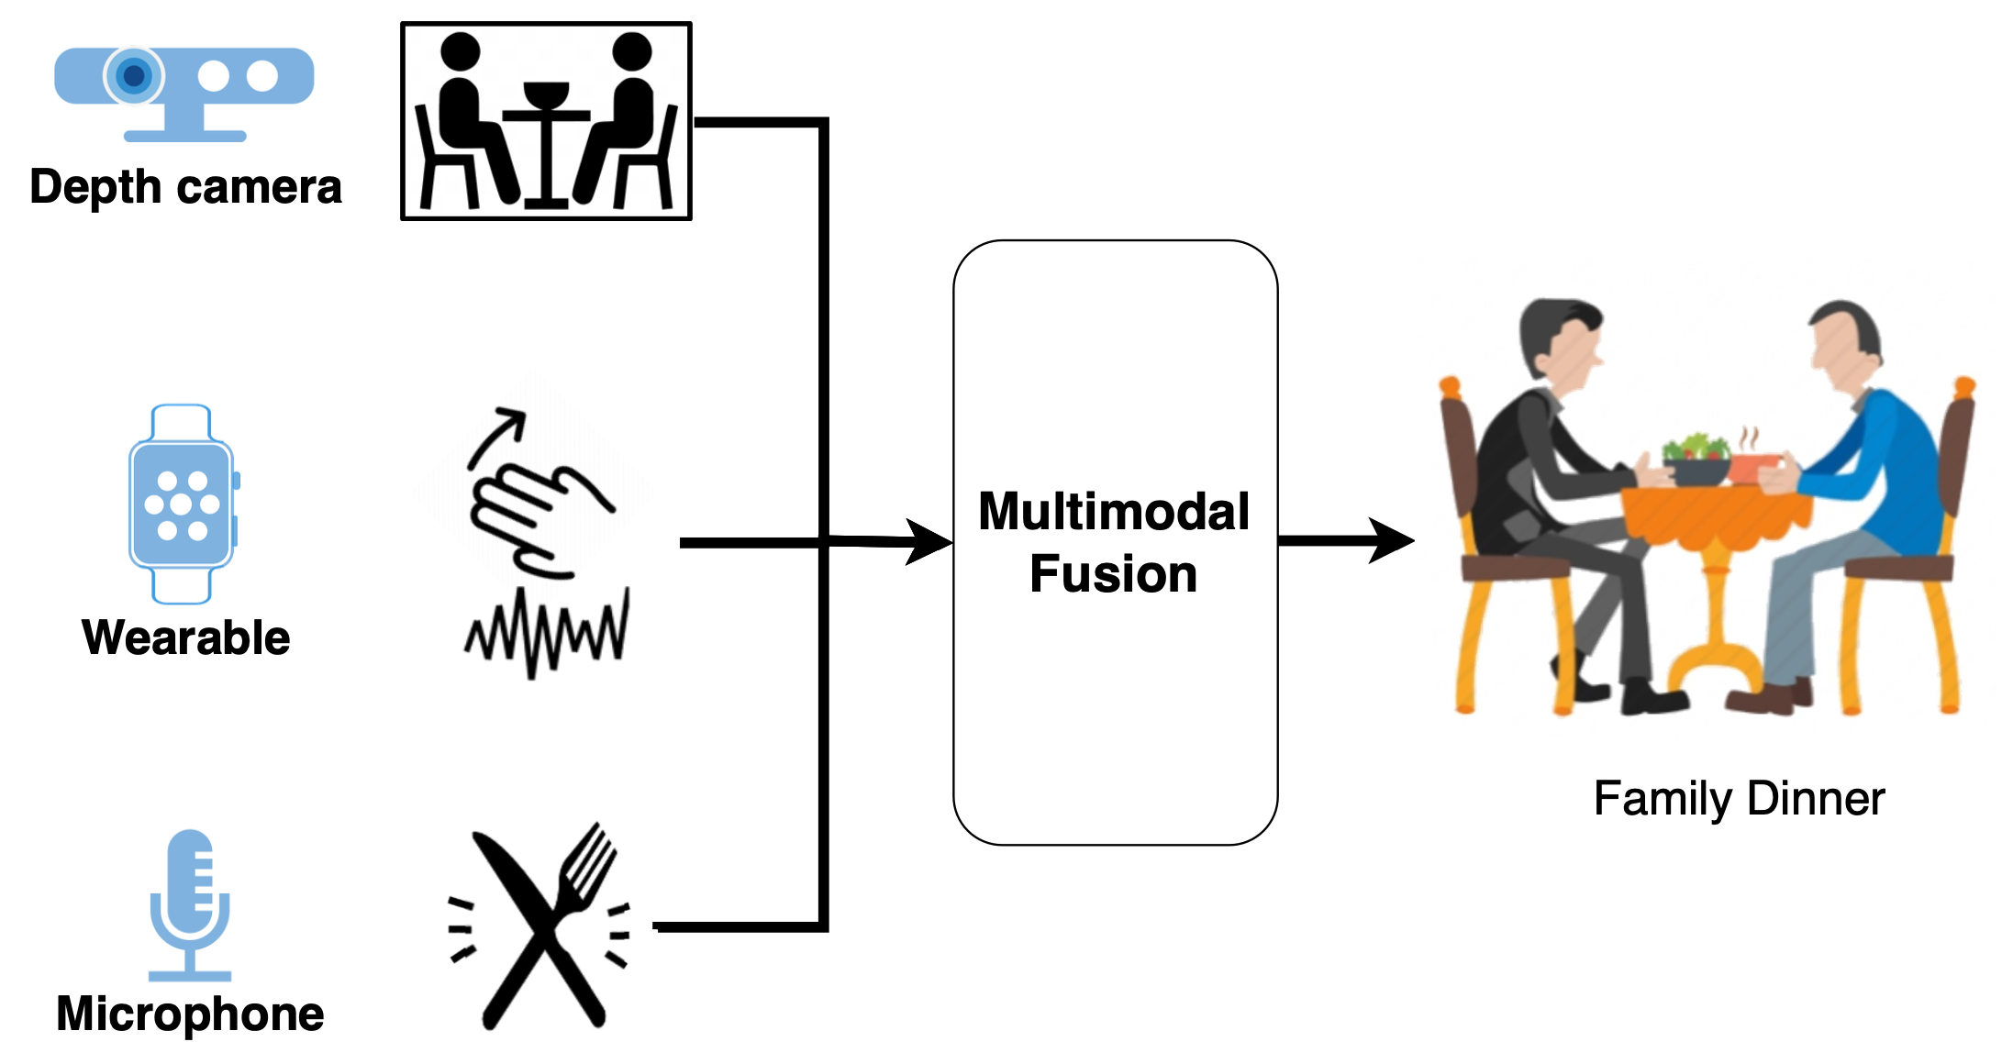
Human Activity Recognition In the Wild
Integrate information of multiple modalities

Slide 4
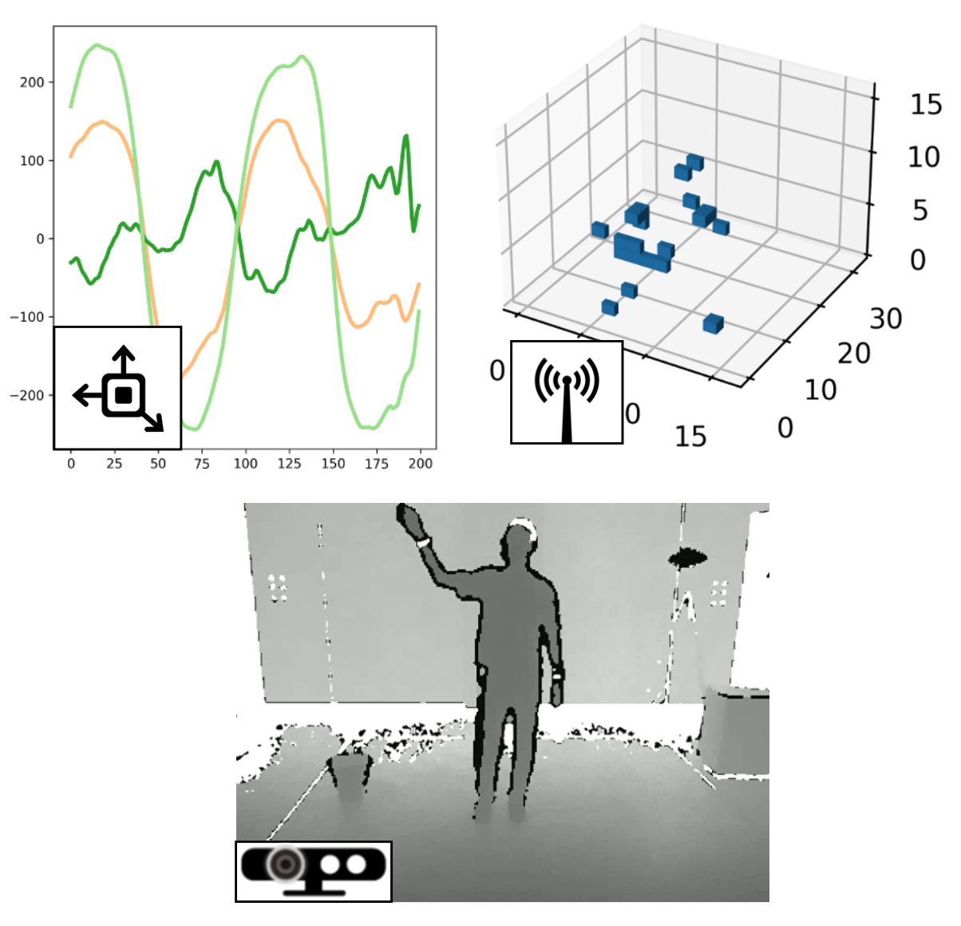
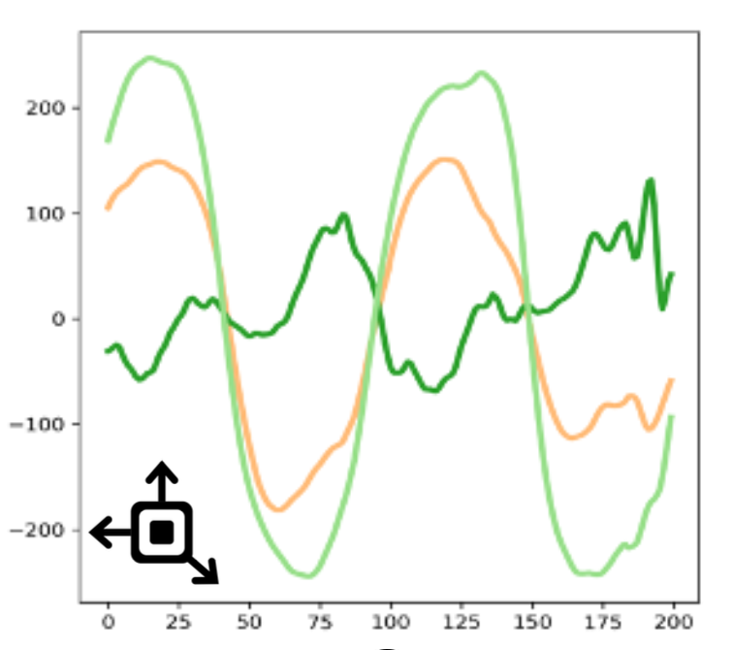




Multimodal HAR: Challenges
Heterogenous sensor data
Limited labels
Privacy and dynamics
Unintuitive for labeling
On-device training

Slide 5
Current solutions
?
Unsupervised
Similar
Heterogenous
Supervised + multimodal HAR
Unsupervised + single-modality HAR
Single-
modality
Multi-modality
Unsupervised + similar multi-modality
Well-studied
Supervised
Key question: How to fuse the heterogeneous sensor data with limited labels in HAR?

Slide 6
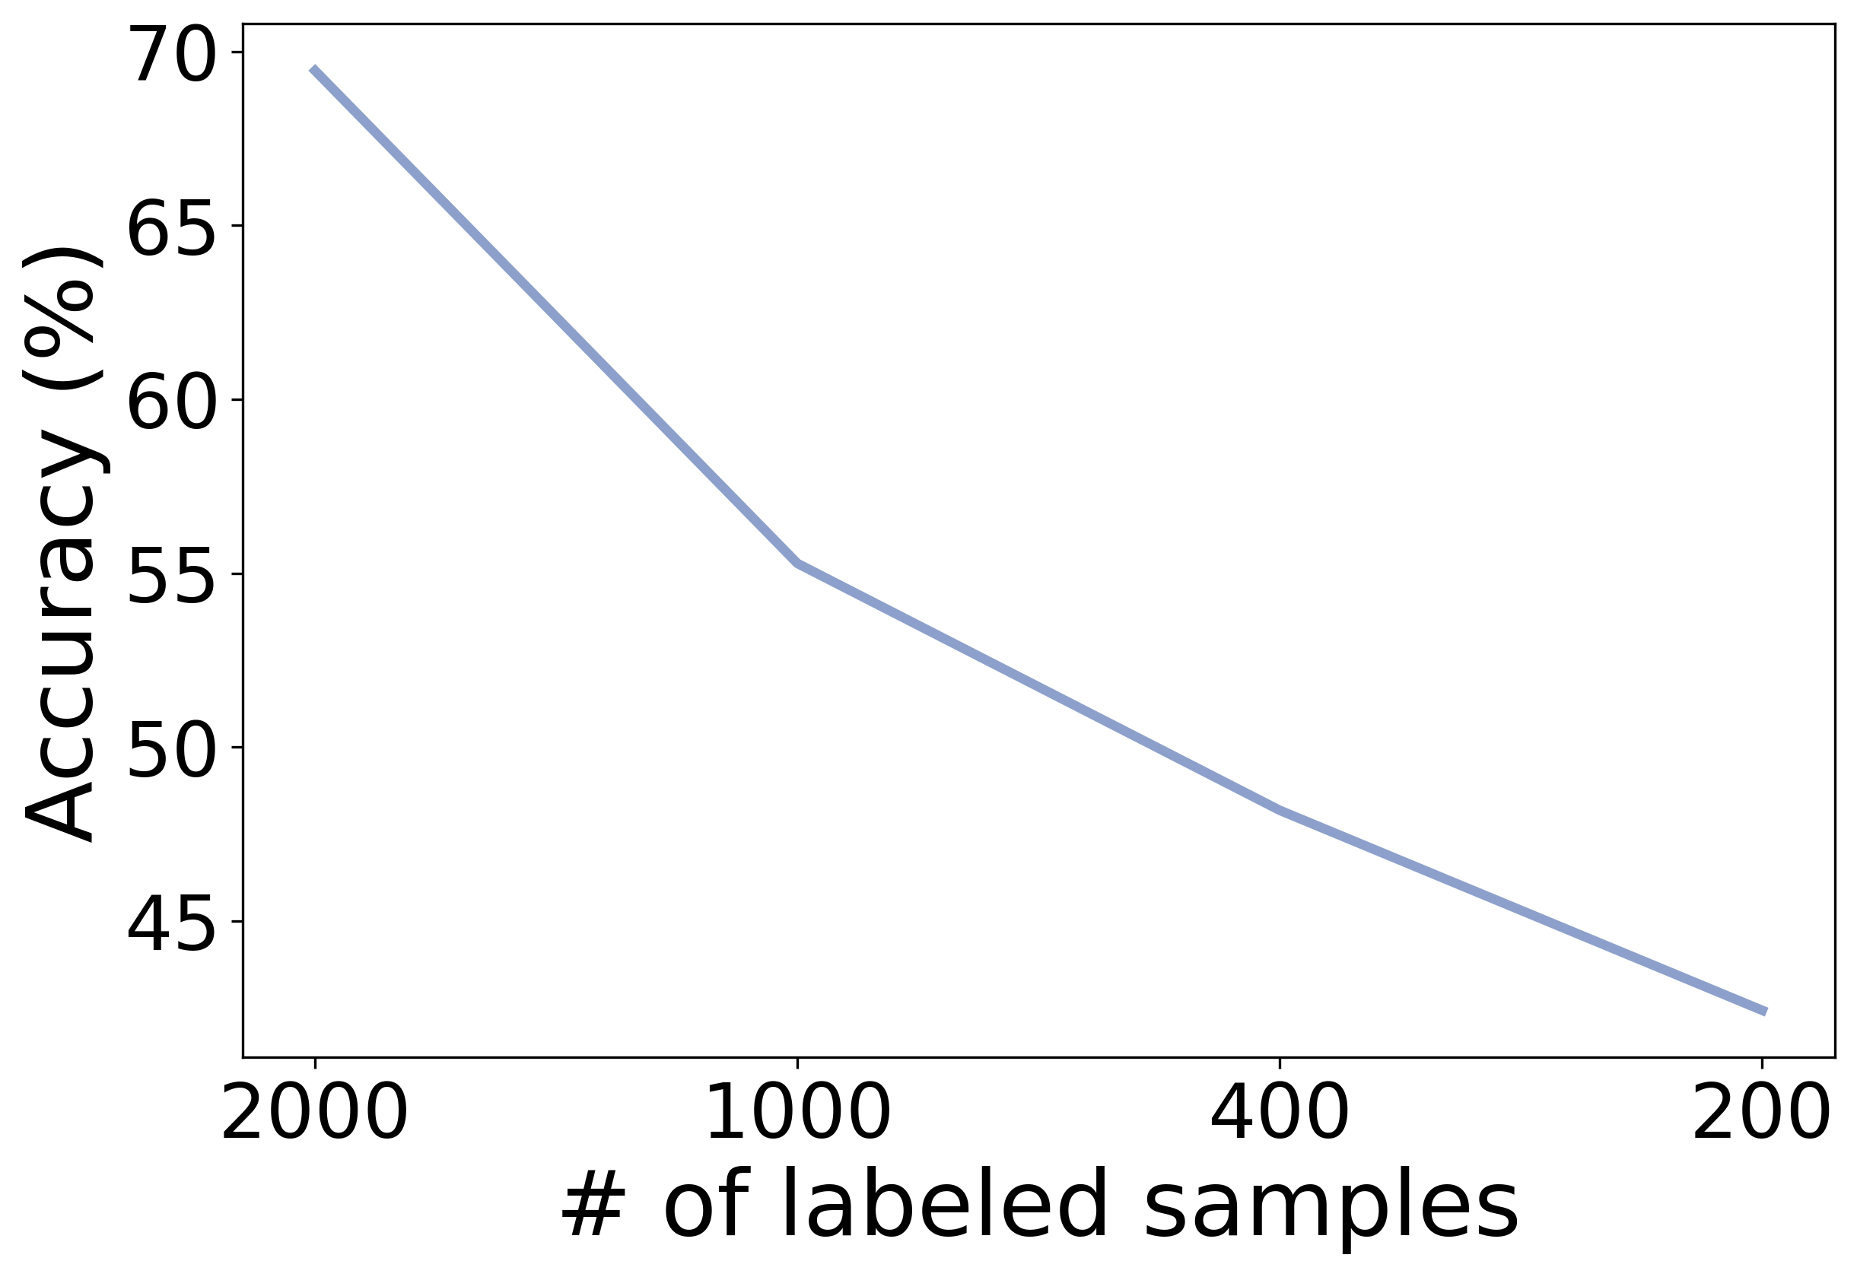
Understanding data fusion
Extract useful information
Impact of small data
Results based on two state-of-art supervised fusion approaches
Challenge: Explore consistent and complementary information from limited labels.

Slide 7

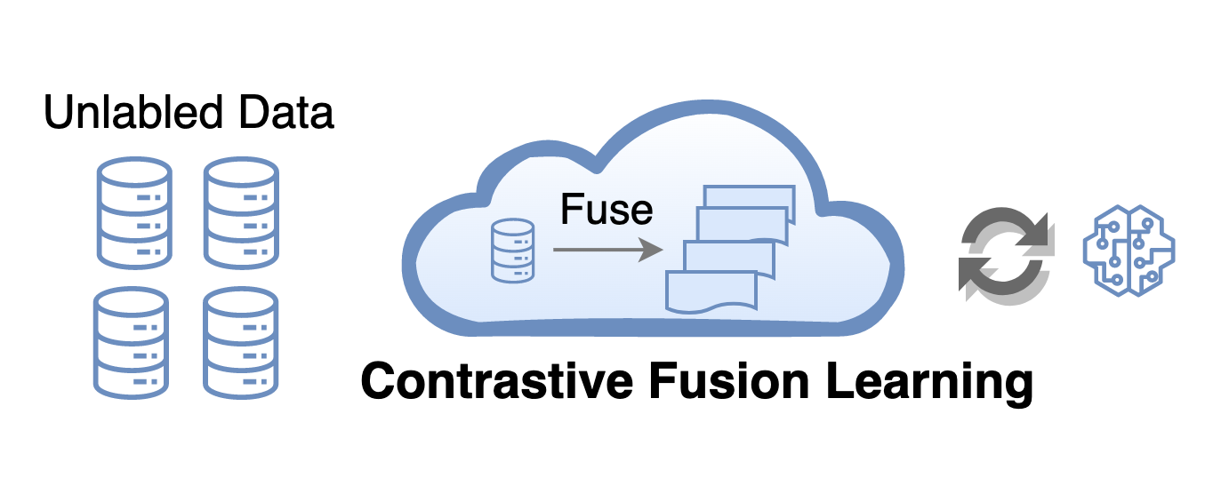
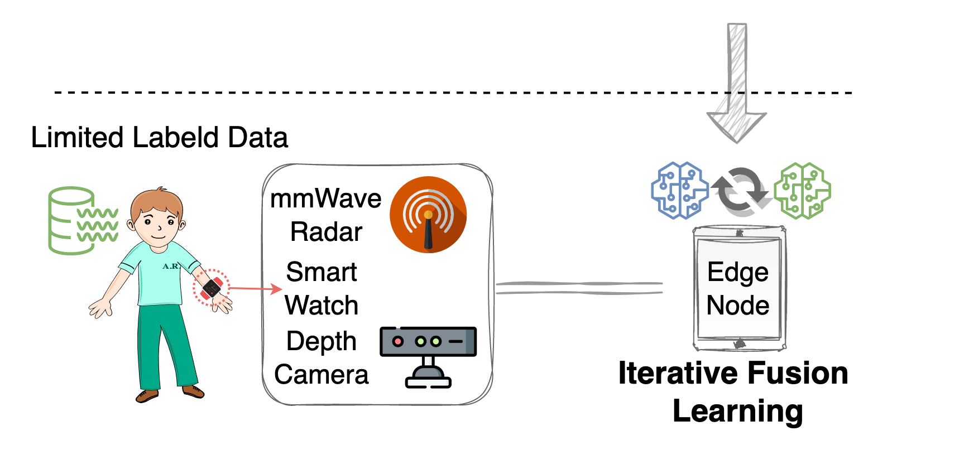
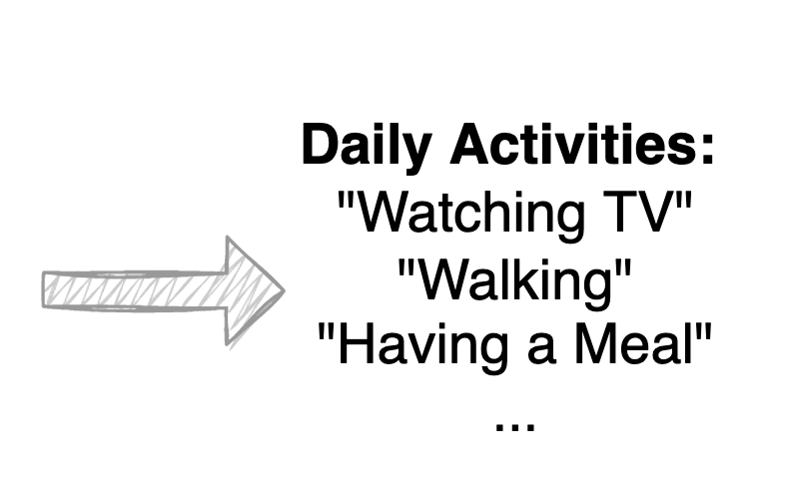
Cosmo: Multimodal HAR with Small Data
Cloud: capture consistent info. without labels.
Edge: combine complementary info. from limited labels.

Slide 8
Contrastive Fusion Learning
Unimodal feature extraction
Fusion-based feature augmentation:
Contrastive learning
Augmentation
Randomly sampled weights
Learn consistent features by maximizing mutual information

Slide 9
Iterative Fusion Learning
Capture complementary information:
Attention module: dynamic fusion weights
- Challenge: train attention layers with only limited labels
Combine the unlabeled data: data quality of modalities

Slide 10
Iterative Fusion Learning
How to combine encoders and classifier?
Iterative training
Direct training may forget some consistent knowledge.
Gradually add complementary info.
Complementary
Complementary
Consistent
Complementary

Slide 11
Cosmo: Put all things together
Explore consistent and complementary info. based on limited labels

Slide 12
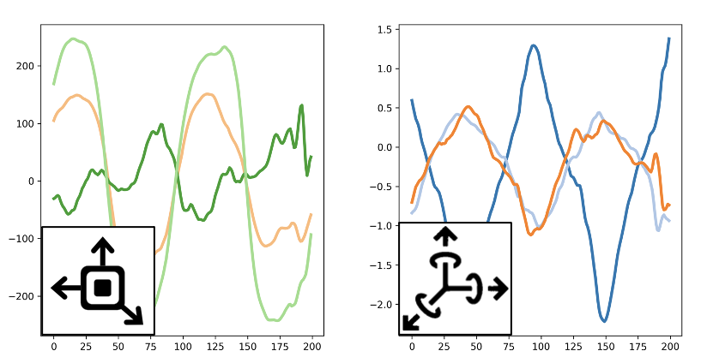
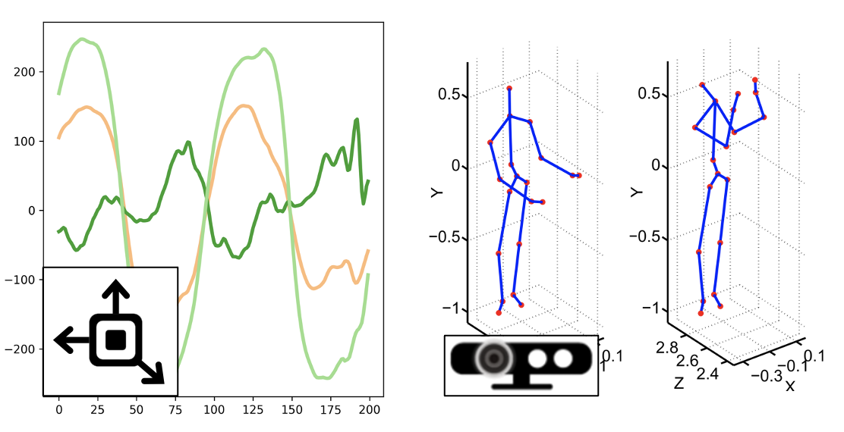
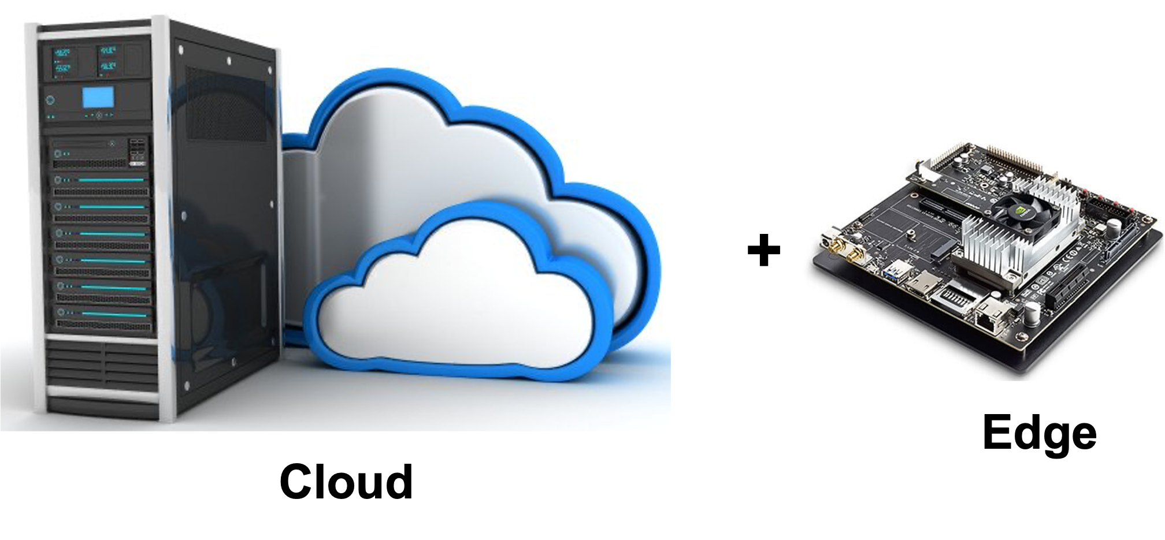
Experiment Setup
Three multimodal HAR datasets including total 5 modalities:
USC dataset
UTD dataset
Self-collected dataset
Cloud-edge implementation:
Baselines:
SingleModal, DeepSense, AttnSense
Contrastive Predictive Coding (CPC)
Contrastive Multi-view Learning (CMC)
8 NVIDIA GEFORE
TITAN GPUs
NVIDIA
Jetson TX2

Slide 13
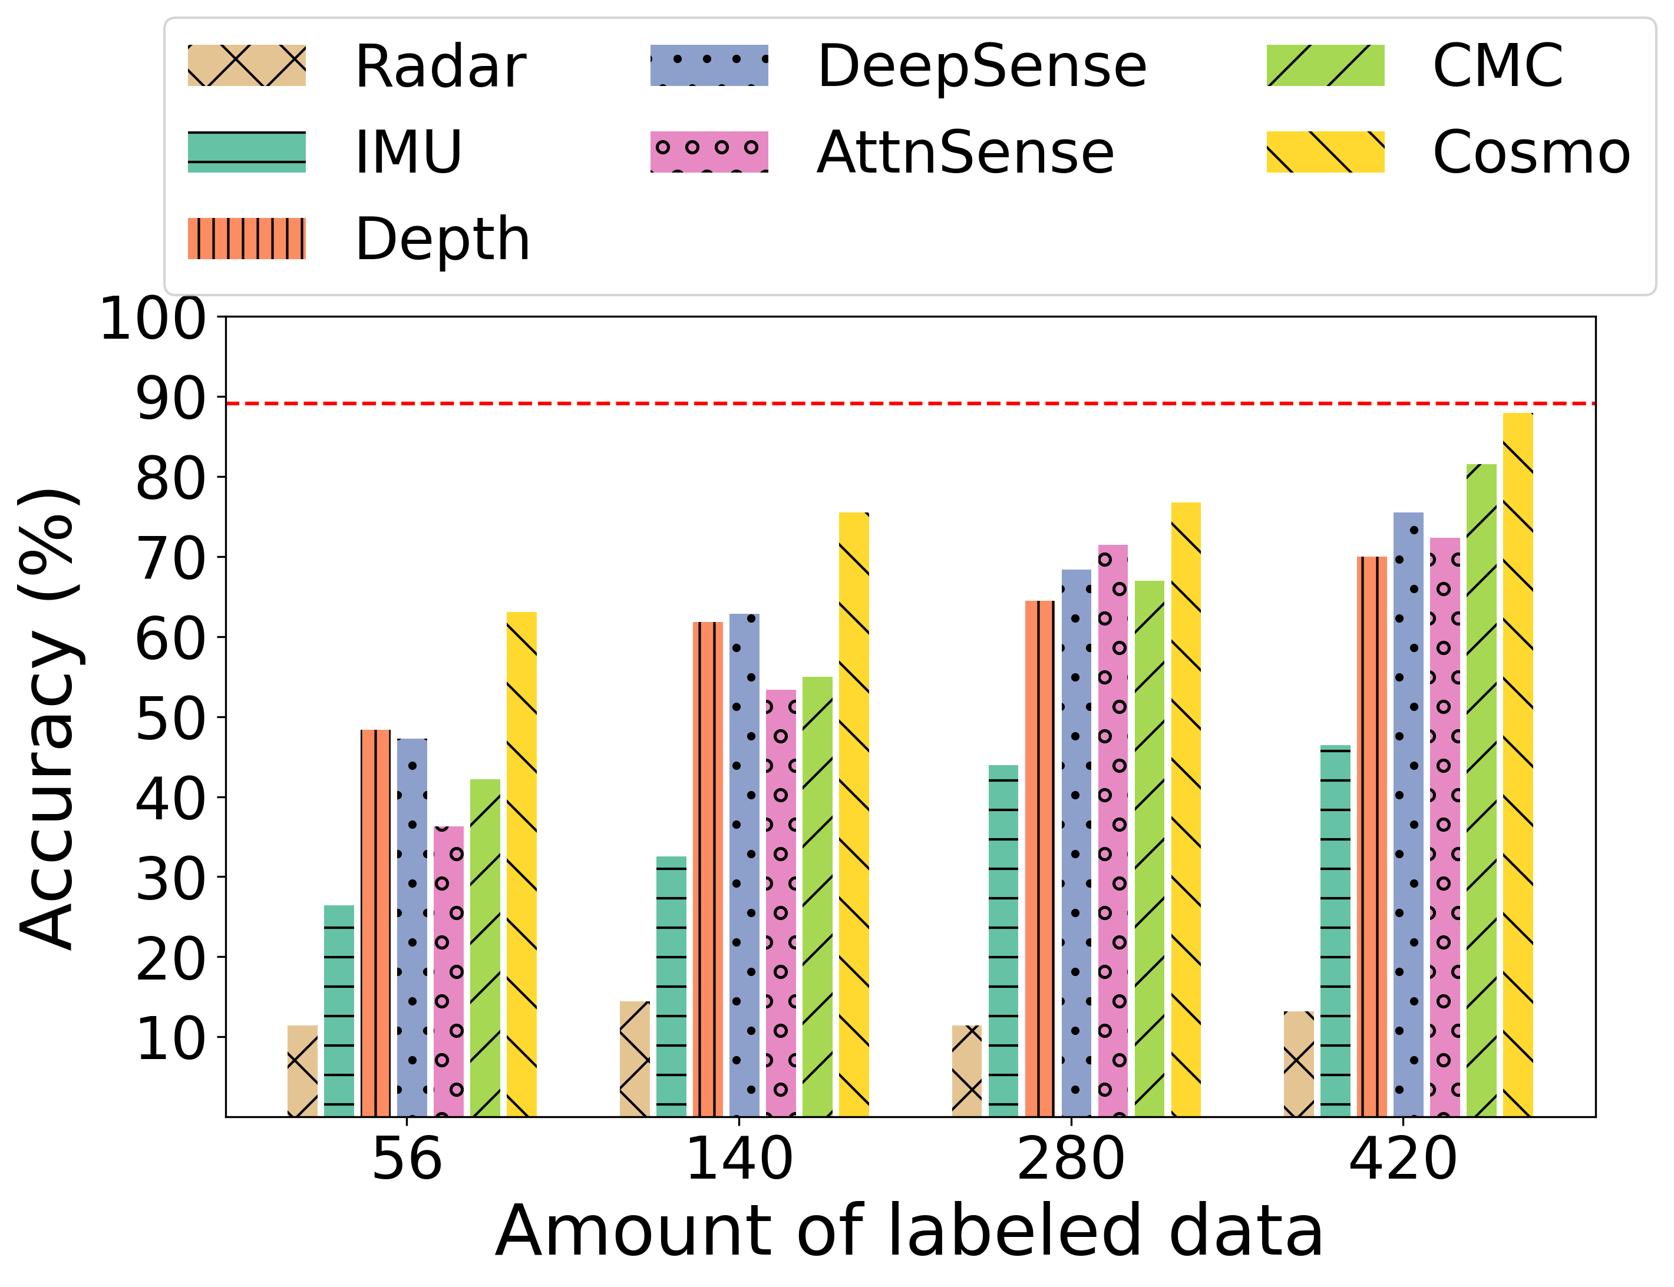
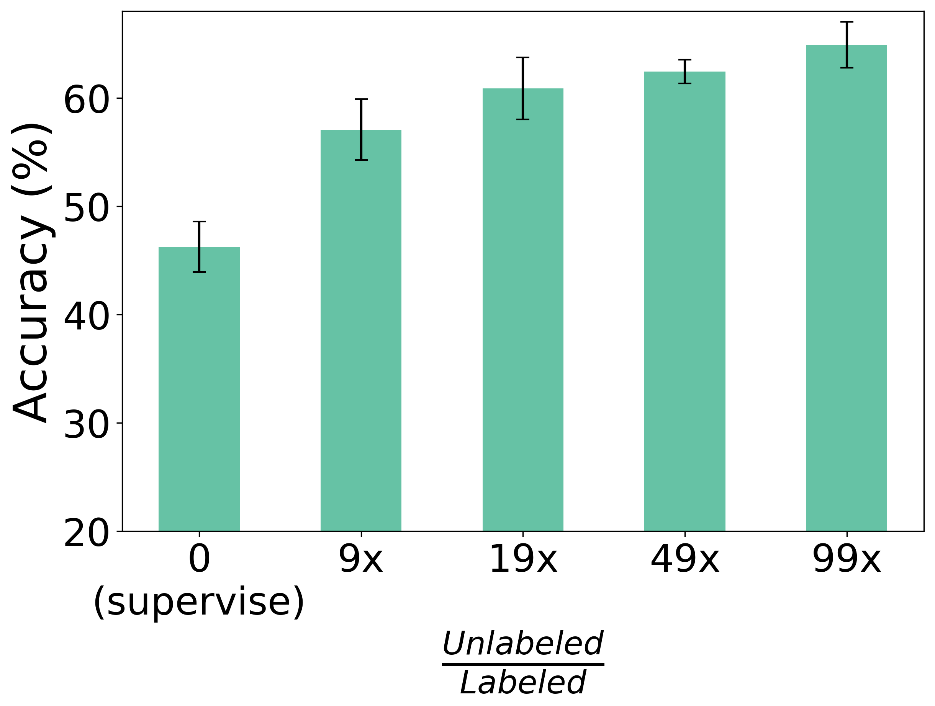
Evaluation: Accuracy
Different amounts of labeled data:
Different amounts of unlabeled data:
About 90% accuracy with 420 labeled samples.
More unlabeled data benefits the accuracy.

Slide 14
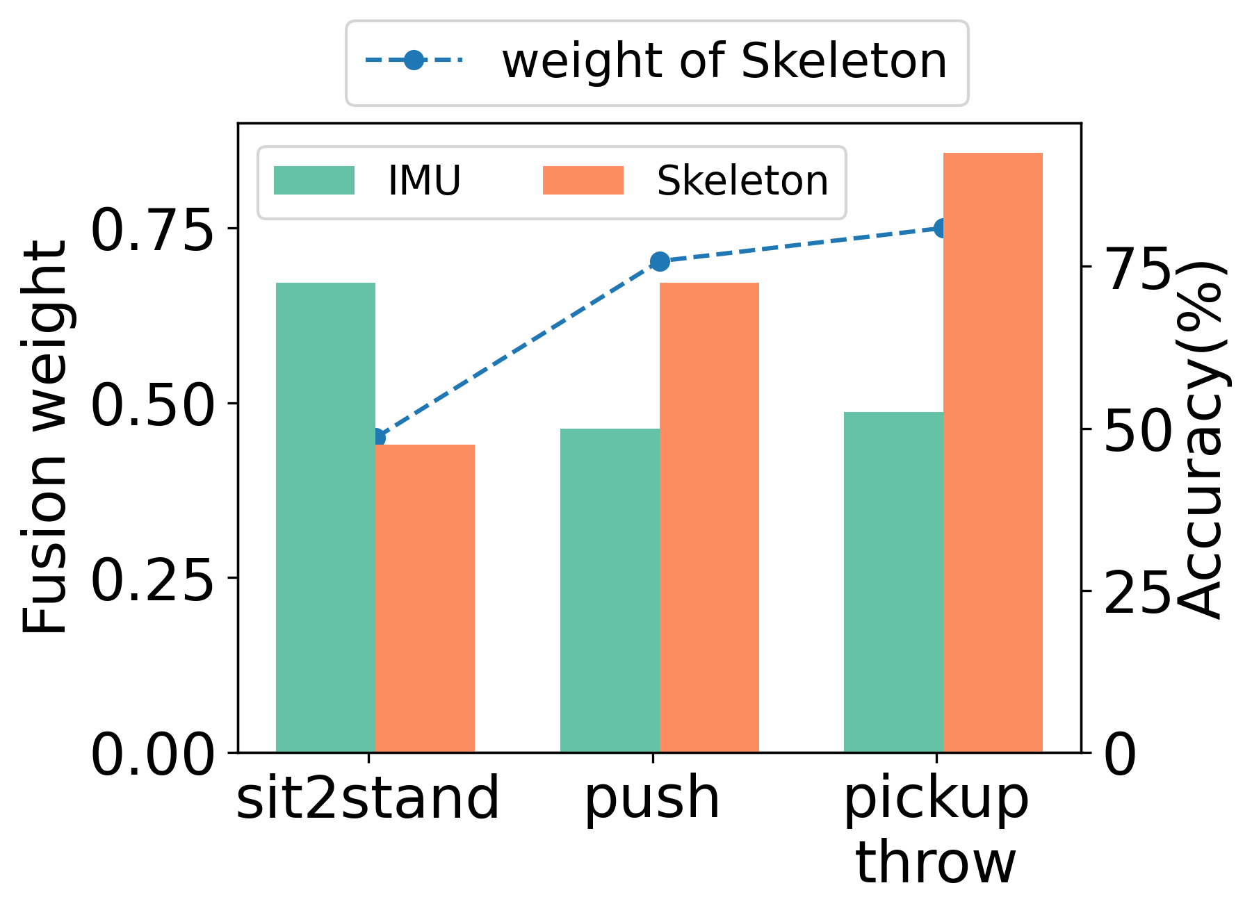
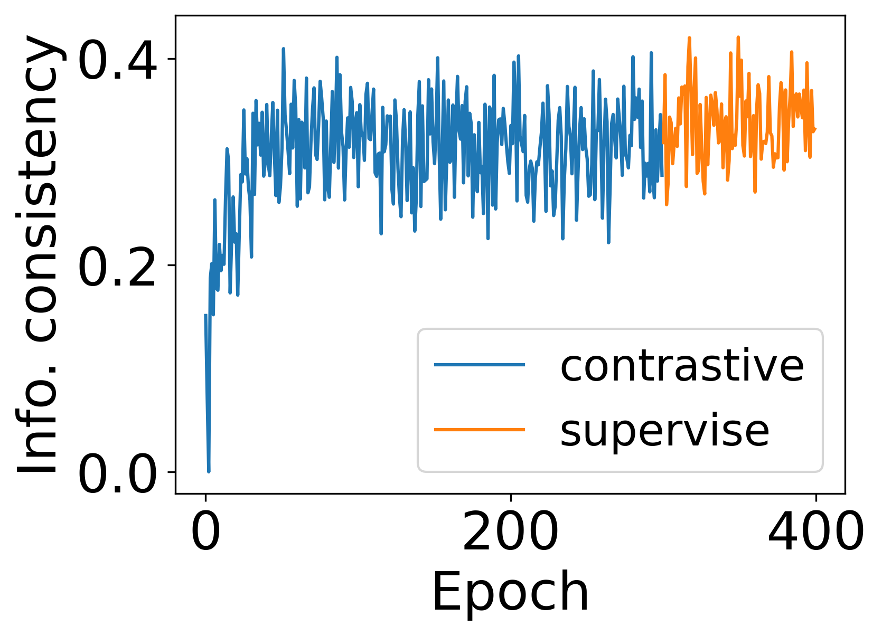
Evaluation: Extracted information
Consistent information:
Complementary information:
Increase in contrastive fusion learning
Dynamic fusion weights

Slide 15
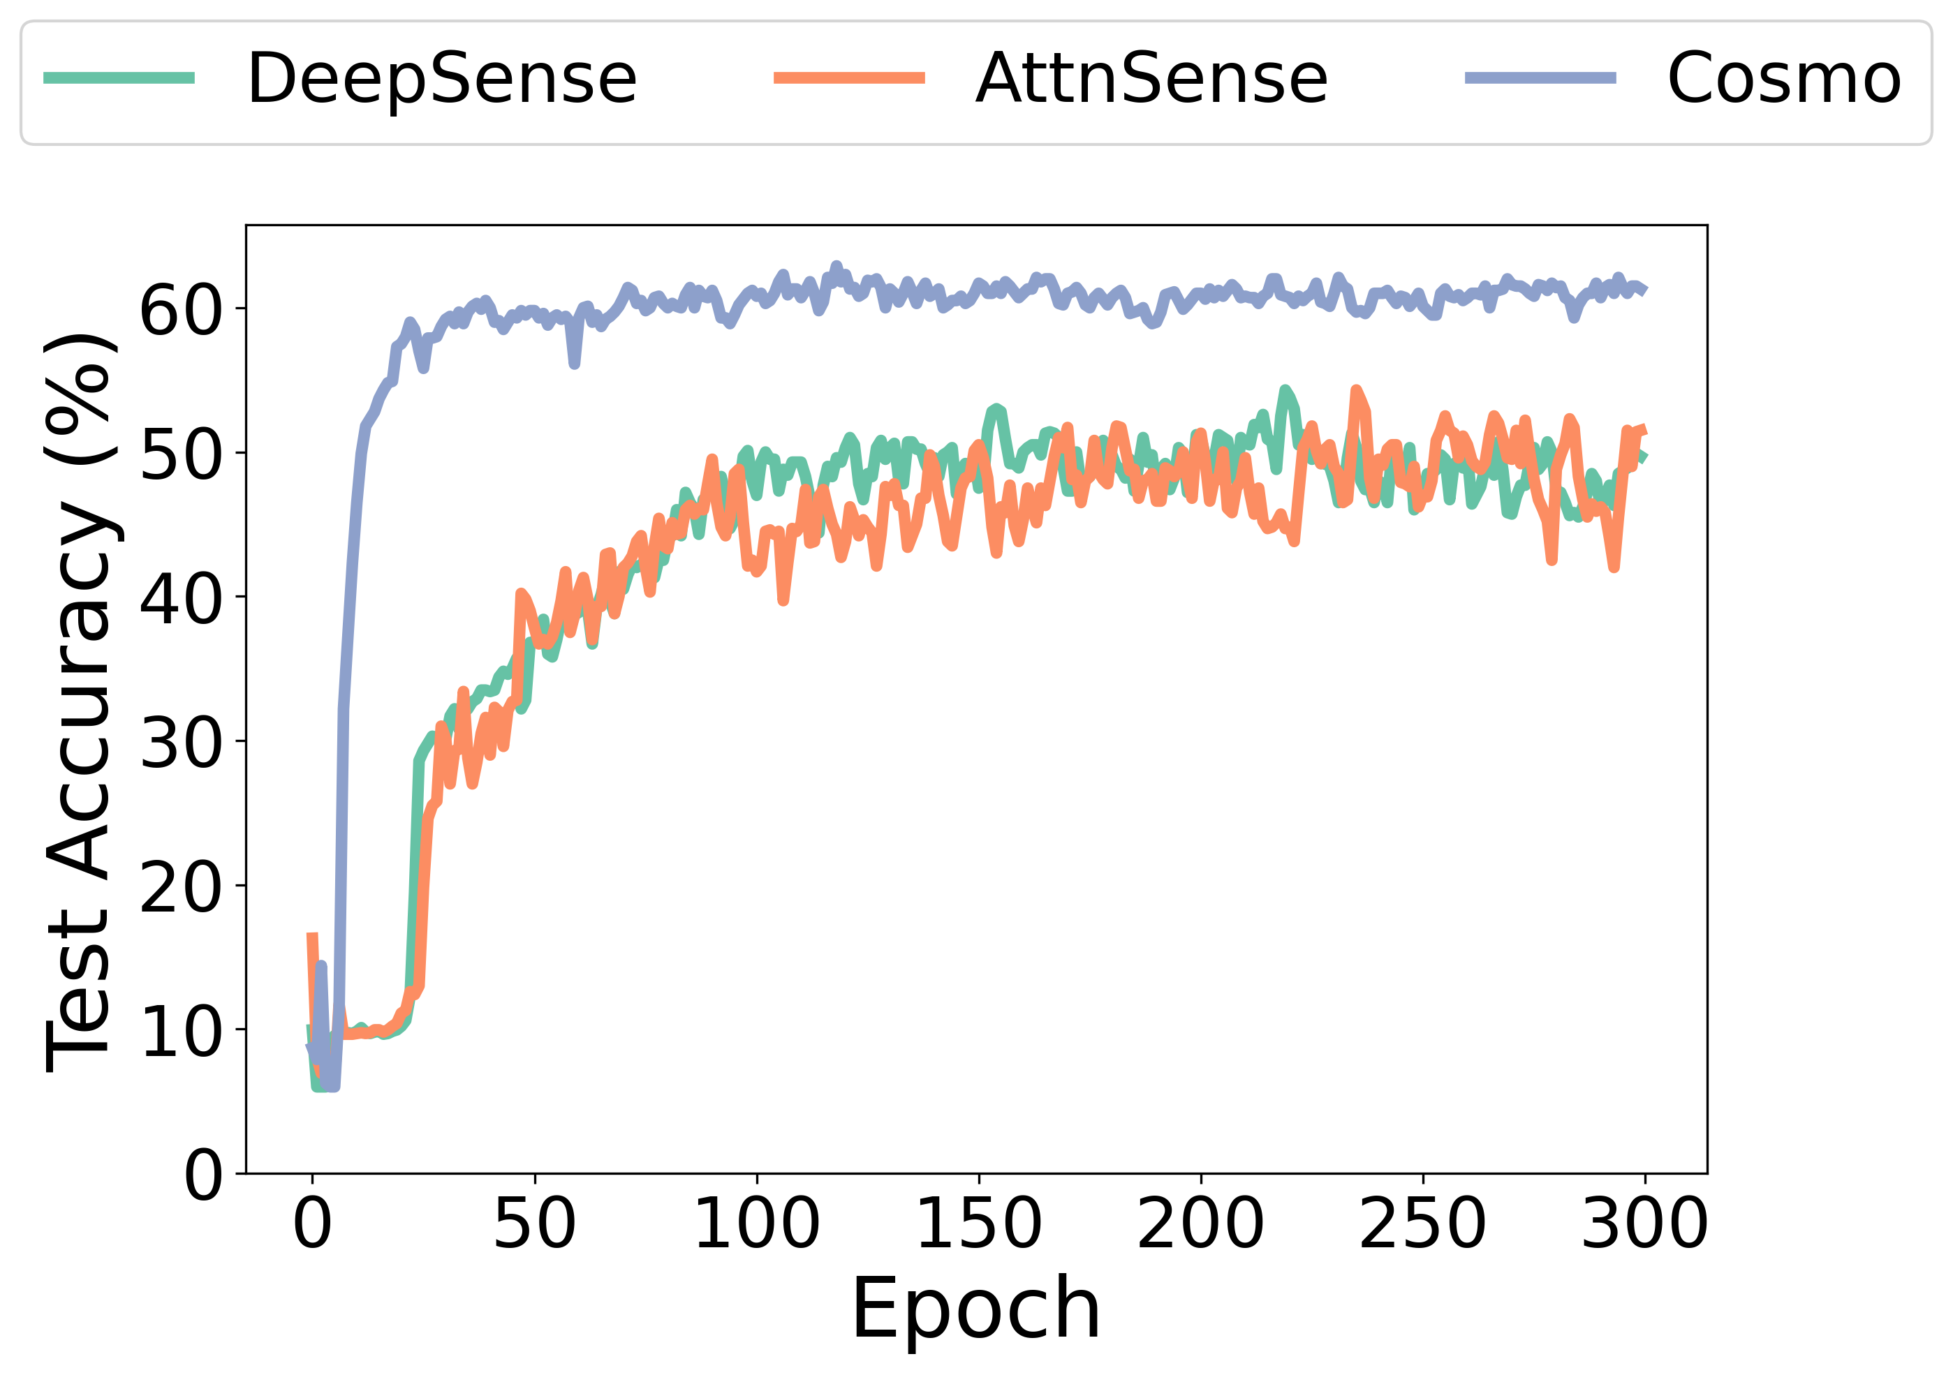
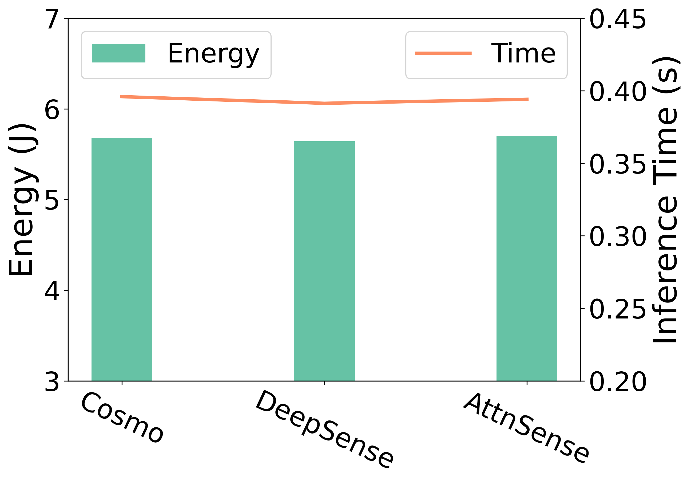
Evaluation: System Efficiency
Convergence:
Inference overhead:
Much faster than baselines
Incurs similar overhead while higher accuracy

Slide 16






Conclusion
Cosmo: A new system for multimodal HAR with small data
Leverage unlabeled and labeled multimodal data
Extract both consistent and complementary information
Future work
Dynamic sensor selection
Incorporate federated learning

Slide 17

Thanks!
Cosmo: Contrastive Fusion Learning with Small Data for Multimodal Human Activity Recognition
Xiaomin Ouyang, Xian Shuai, Jiayu Zhou, Ivy Wang Shi, Zhiyuan Xie, Guoliang Xing, and Jianwei Huang
http://aiot.ie.cuhk.edu.hk/

